Slide 1

LECTURE 7: Object Oriented Design
Instructor: Maria Striki
Presentation: Ivan Marsic, Maria Striki
Rutgers University

Slide 2

Topics
Assigning Responsibilities to Objects
Design Principles
    Expert Doer
    High Cohesion
    Low Coupling
Business Policies
Class Diagram

Slide 3
System Sequence Diagrams
We already worked with interaction diagrams: System Sequence Diagrams
User
«initiating actor»
: System
Timer
«offstage actor»
select function(“unlock")
prompt for the key
enter key
verify key
signal: valid key, lock open
open the lock,
turn on the light
start ("duration“)
System Sequence Diagrams considered interactions between the actors

Slide 4
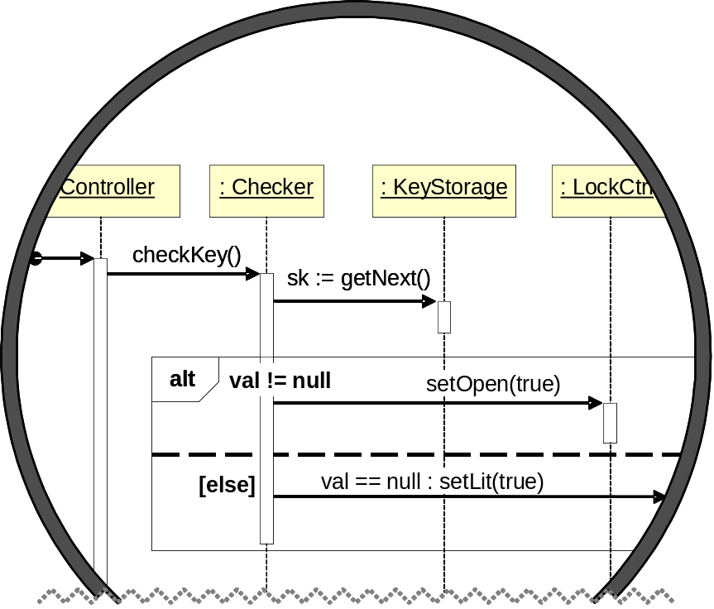
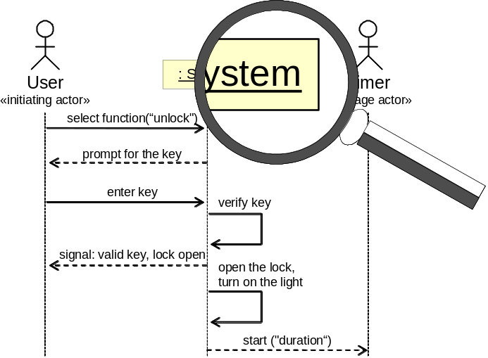
Design: Object Interactions
Design
Sequence Diagram
System Sequence Diagram
System Sequence Diagrams considered interactions between the actors
Object Sequence Diagrams consider interactions between the objects

Slide 5
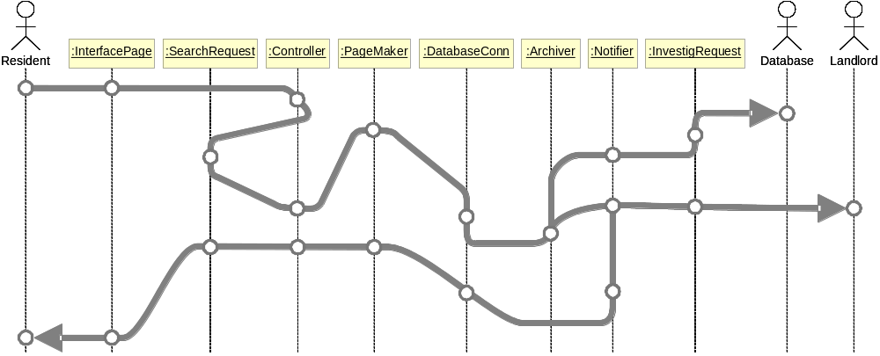
Metaphor for Software Design: “Connecting the Dots”
We start with objects/concepts from the Domain Model and modify or introduce new objects, as needed to make the system function work.

Slide 6
Types of Object Responsibilities
Knowing responsibility: Memorizing data or references, such as data values, data collections, or references to other objects, represented as a property
Doing responsibility: Performing computations, such as data processing, control of physical devices, etc., represented as a method
Communicating responsibility: Communicating with other objects, represented as message sending (method invocation)

Slide 7
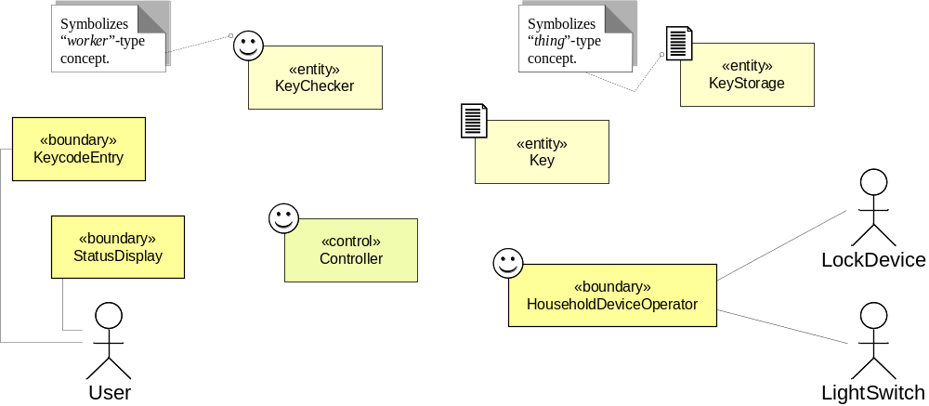
How To “Connect the Dots”
Starting Points:
Domain Model from UC-1 (domain concepts):
Use Case UC-1: Unlock (flow of events):
1. User enters the key code
2. System verifies that the key is valid
3. System signals the key validity
4. System signals:
(a) to LockDevice to disarm the lock
(b) to LightSwitch to turn the light on
Scenario Walkthrough:
for mapping a Use Case scenario to the Domain Model
Q: who handles this data?
Interface objects and Controller
message: checkKey(k)
Q: who performs the verification? Based on what data?
return value
Key Checker, based on entered key-code and stored valid keys
message: ???
Q: who signals? Based on what data?
Controller and Interface objects, based on key verification; because they are «boundary»
Q: who signals? Based on what data?
Controller or Key checker ???, based on key verification

Slide 8
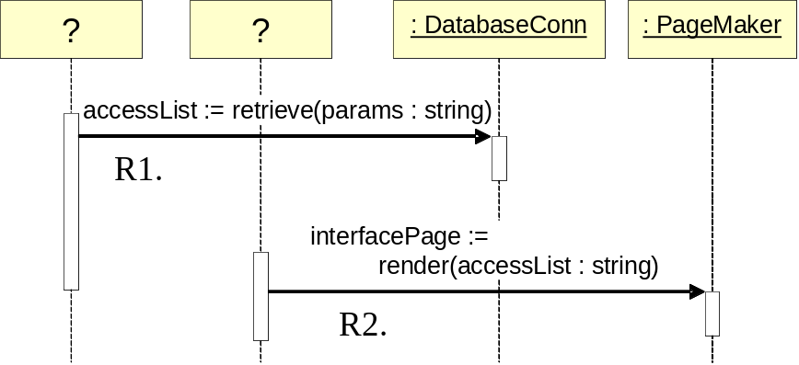
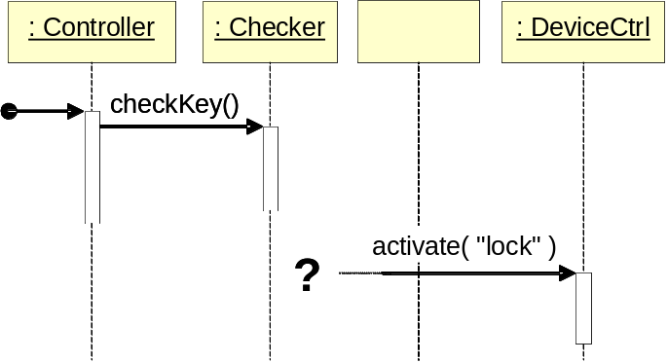
Design: Assigning Responsibilities
(a)
(b)

Slide 9
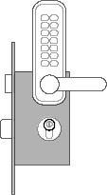
How Data Travels
Option A:
“expert” (Key Checker) passes the information (key validity) to another object (Controller)
which uses it to perform some work (activate the lock device)
key-code
key-code
is-valid
activation-params
Controller
Checker
Controller
LockCtrl
“expert” on key validity
Option B:
“expert” (Key Checker) directly uses the information (key validity)
to perform some work (activate the lock device)
Advantage:
Shorter communication chain
Drawback:
Extra responsibility for Checker
key-code
key-code
activation-params
Controller
Checker
LockCtrl
“expert” on key validity

Slide 10
Characteristics of Good Designs
Short communication chains between the objects
Balanced workload across the objects
Low degree of connectivity (associations) among the objects
method_1()
method_1()
method_2()
…
method_N()

Slide 11
Design Principles
Expert Doer Principle: that who knows should do the task
High Cohesion Principle: do not take on too many computation responsibilities
Low Coupling Principle: do not take on too many communication responsibilities
There are many more …

Slide 12
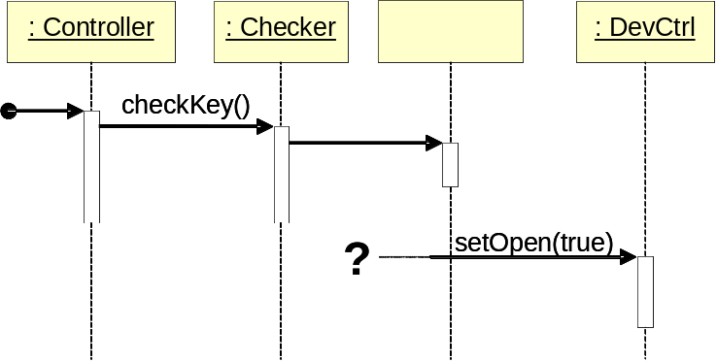
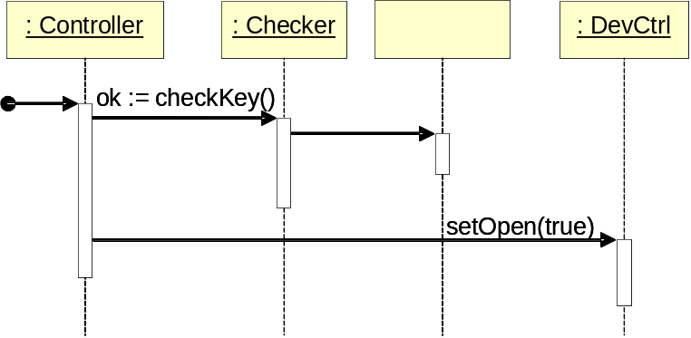
Design: Assigning Responsibilities
(a)
(b)
Although the Checker is the first to acquire the information about the key validity, we decide to assign the responsibility to notify the LockCtrl to the Controller.
This is because the Controller would need to know this information anyway—to inform the user about the outcome of the key validity checking.
In this way we maintain the Checker focused on its specialty and avoid assigning too many responsibilities to it.

Slide 13
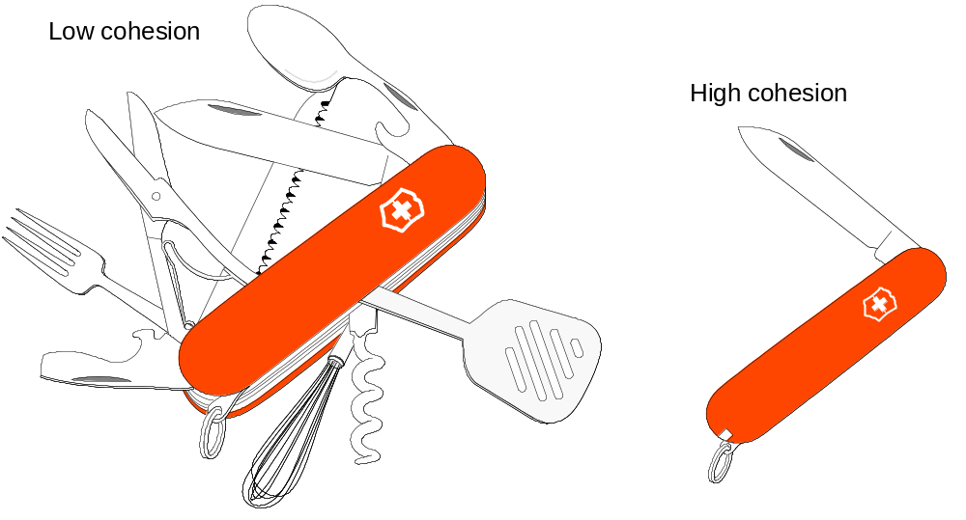
Cohesion

Slide 14
Responsibility-Driven Design
Identify the responsibilities
    domain modeling provides a starting point
    some will be missed at first and identified in subsequent iterations
For each responsibility, identify the alternative assignments
  if the choice appears to be unique then move to the next responsibility
Consider the merits and tradeoffs of each alternative by applying the design principles
  select what you consider the “optimal” choice
Document the process by which you arrived to each responsibility assignment

Slide 15
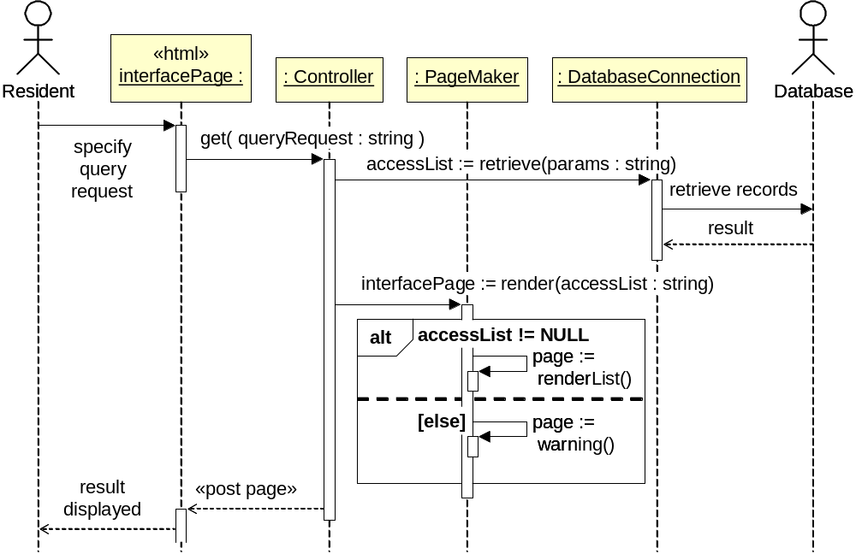
UC-4: View Access Log

Slide 16
Example …
Communicating responsibilities identified for the system function “enter key”:
Responsibility Description
Send message to Key Checker to validate the key entered by the user.
Send message to DeviceCtrl to disarm the lock device.
Send message to DeviceCtrl to switch the light bulb on.
Send message to PhotoObserver to report whether daylight is sensed.
Send message to DeviceCtrl to sound the alarm bell.

Slide 17
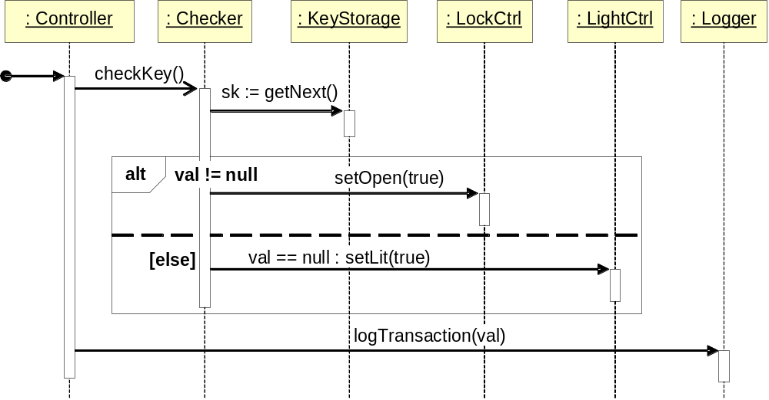
Unlocking Sequence Diagram
sk = stored key; the process either terminates by matching a stored key or exhausting the key store.
Key is a dynamic object, unlike others which are static contains keycode, name, other forms of ID, timestamp, door ID, … -- disposed of after checking

Slide 18
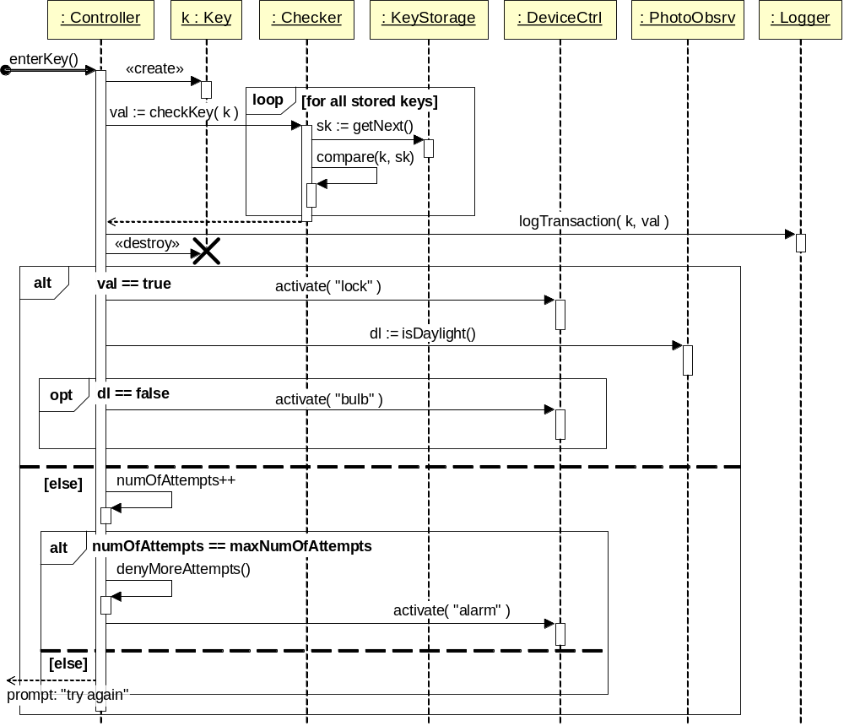
Unlock Use Case
Notes:
We built an undue complexity into the Controller while striving to preserve high degree of specialization for all other objects. [[ Note: GUI aspects are treated separately. ]]

Slide 19
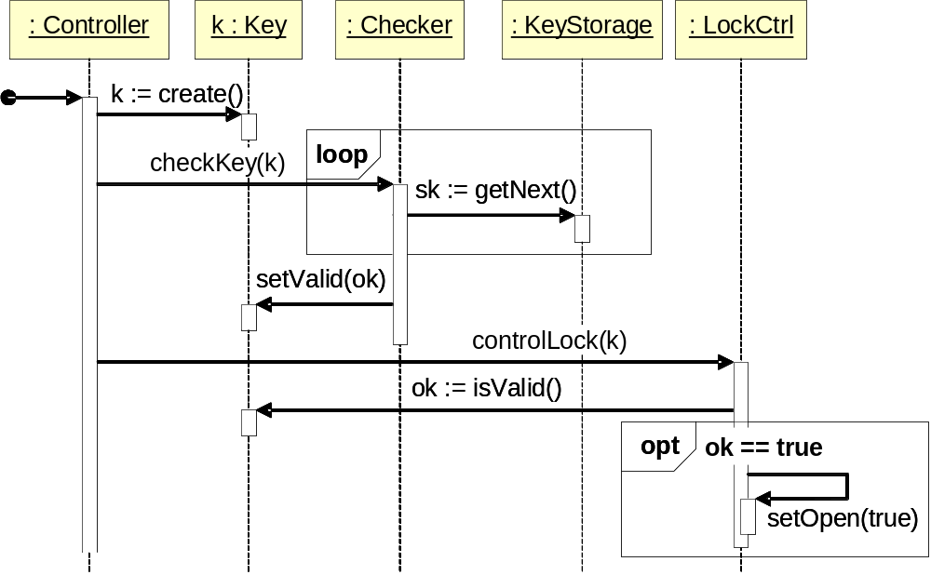
Unlock Seq. Diag. Variation 1
To avoid an impression that the above design is the only one possible!!
Sets a boolean attribute of the Key object: ok = true/false;
Business logic (IF-THEN rule) relocated from Controller to LockCtrl

Slide 20
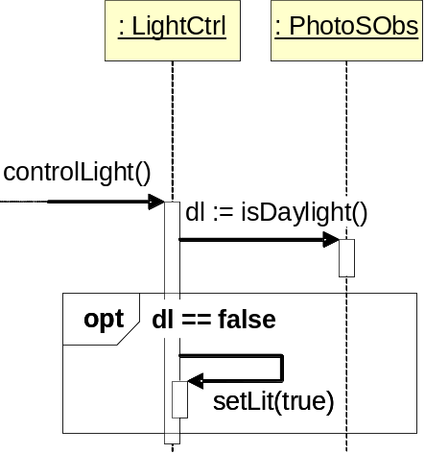
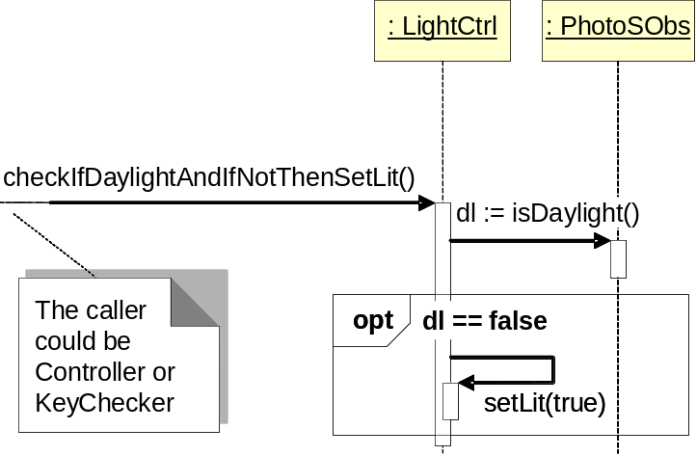
Unlock Seq. Diag. Variations 2&3
Depends on which solution you consider more elegant;
It is helpful that checkIfDaylightAndIfNotThenSetLit() is named informatively (reveals the intention), but the knowledge encoded in the name of the method is imparted onto the caller.

Slide 21
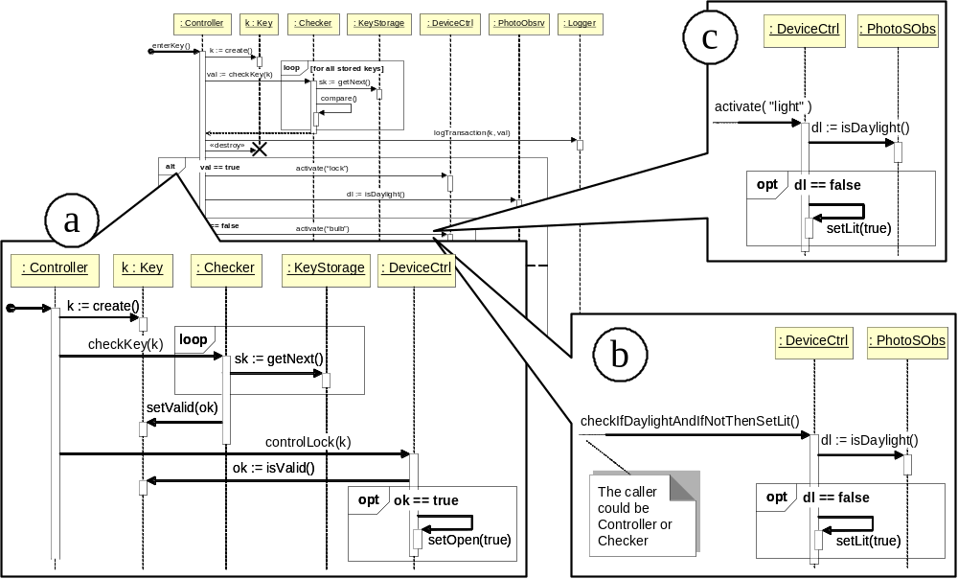
Summary of Design Variations

Slide 22
Are We Done w/ UC-1: Unlock ?
Didn’t check that the user is at the right door
  Missing: Managing access rights
Didn’t distinguish critical and non-critical functions
  For example, what if logTransaction() call to Logger does not return, e.g., no access to database (network outage) or disk-space full ?
  Missing: Independent execution of non-critical functions
Adding new household devices causes major design changes
Business rules are interleaved with authentication and device management, but business rules are most likely to change
Etc.

Slide 23
Business Policies
IF key ∈ ValidKeys THEN disarm lock and turn lights on
ELSE
increment failed-attempts-counter
IF failed-attempts-counter equals maximum number allowed
THEN block further attempts and raise alarm
Should be moved into a separate object:
Make them explicit part of the model
Confine the future changes in business policies

Slide 24
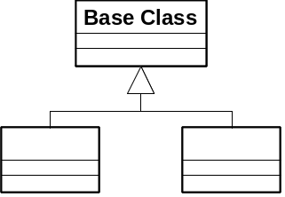

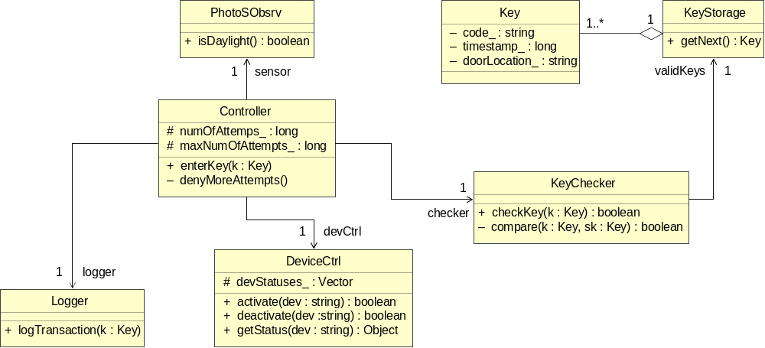
Class Diagram

Slide 25
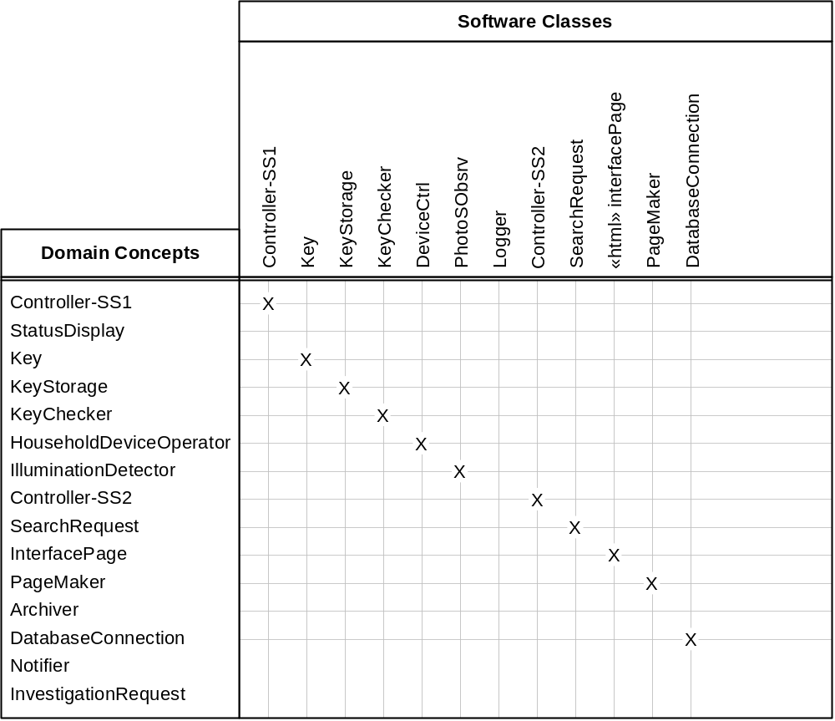
Traceability Matrix (3)
Mapping: Domain model to Class diagram

Slide 26
Types of Object Communication
S₁
A
B
A
B
P
S₂
S_{N}
(a)
(b)
(c)

